Slide 1
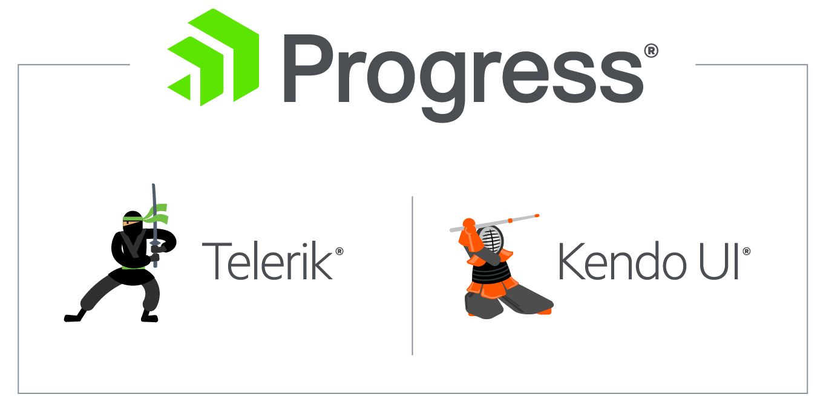

for
Notes:
Welcome to today’s lecture
It will be about Kendo UI for jQuery
Original kendo, the oldest one
Who is this training for
Technical stuff/issues introduce team
Submit questions about Kendo to using the submit question function
Either myself or my team will answer them and if I can I will address the question during the presentation
Materials available: https://github.com/newventuresoftware/kendo-ui-for-jquery

Slide 2

{Welcome to Progress Virtual Classroom}
Notes:
I am very honored to welcome you to the Progress Virtual Classroom. This is an initiative from Progress Software done in partnership with New Venture Software for all customers with a valid license. Progress Telerik tools have a long history of excellent quality, frequent updates, great documentation and industry leading support. When thinking how to improve the already great offering they decided to create Virtual Classroom and to provide all of it’s customers with the best in-class training as well. We understand developers have a choice when it comes to selecting a UI component vendor and we truly hope this gives you even more arguments to staying a loyal Progress customer.

Slide 3
Date | Time | Course
June 26, 2018 | 9am - 1pm EST | Kendo UI & Angular
June 27, 2018 | 9am - 1pm EST | Kendo UI & jQuery
July 10, 2018 | 9am - 1pm EST | Telerik UI for ASP.NET MVC and ASP.NET Core
July 11, 2018 | 9am - 1pm EST | Kendo UI & Vue
July 12, 2018 | 9am - 1pm EST | Kendo UI & React
July 13, 2018 | 9am - 1pm EST | Telerik UI for Xamarin
July 16, 2018 | 9am - 1pm EST | Telerik UI for WPF
July 17, 2018 | 9am - 1pm EST | Telerik Reporting & Telerik Report Server
July 19, 2018 | 9am - 1pm EST | Telerik UI for ASP.NET AJAX
July 24, 2018 | 9am - 1pm EST | Telerik UI for WinForms
July 26, 2018 | 9am - 1pm EST | Telerik UI for UWP
Notes:
With more than 30 hours of technical content created in partnership with New Venture Software, Virtual Classroom is designed to quickly get you onboard and successful with our developer tools whether you’ve been using them for years or are new to the suite. Each session will provide practical knowledge combined with helpful approaches to application development.
Here you can seen on your screens the schedule for the second season of trainings.
Web:
-Kendo UI fully covered
-MVC & Core
-Ajax
Desktop:
-WPF
-Winforms
-UWP
Mobile:
-Xamarin
Business intelligence:
-Reporting and Reporting Server
With this in mind it is important for us to receive your feedback and let us know if we can improve anything for the next iteration. Feel free to submit your feedback as we move along in the form of a question or contact me personally by email.

Slide 4
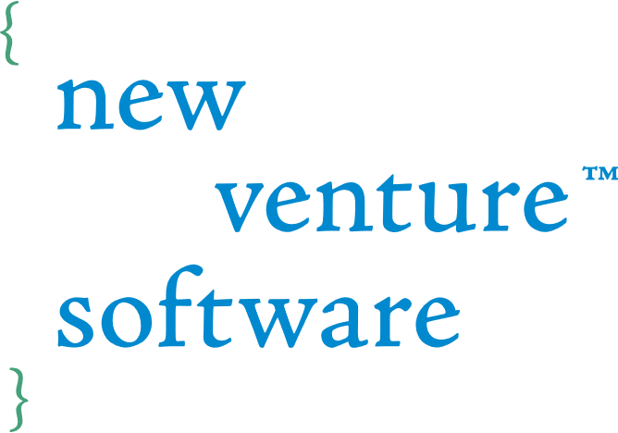








Vladimir Milev
Chief Software Architect @
vladi@newventuresoftware.com
github.com/vmilev
vmilev
Notes:
-Read the basic info on the slide
-Great history with Telerik & Progress
-Invite to follow on twitter and on the newventuresoftware blog

Slide 5
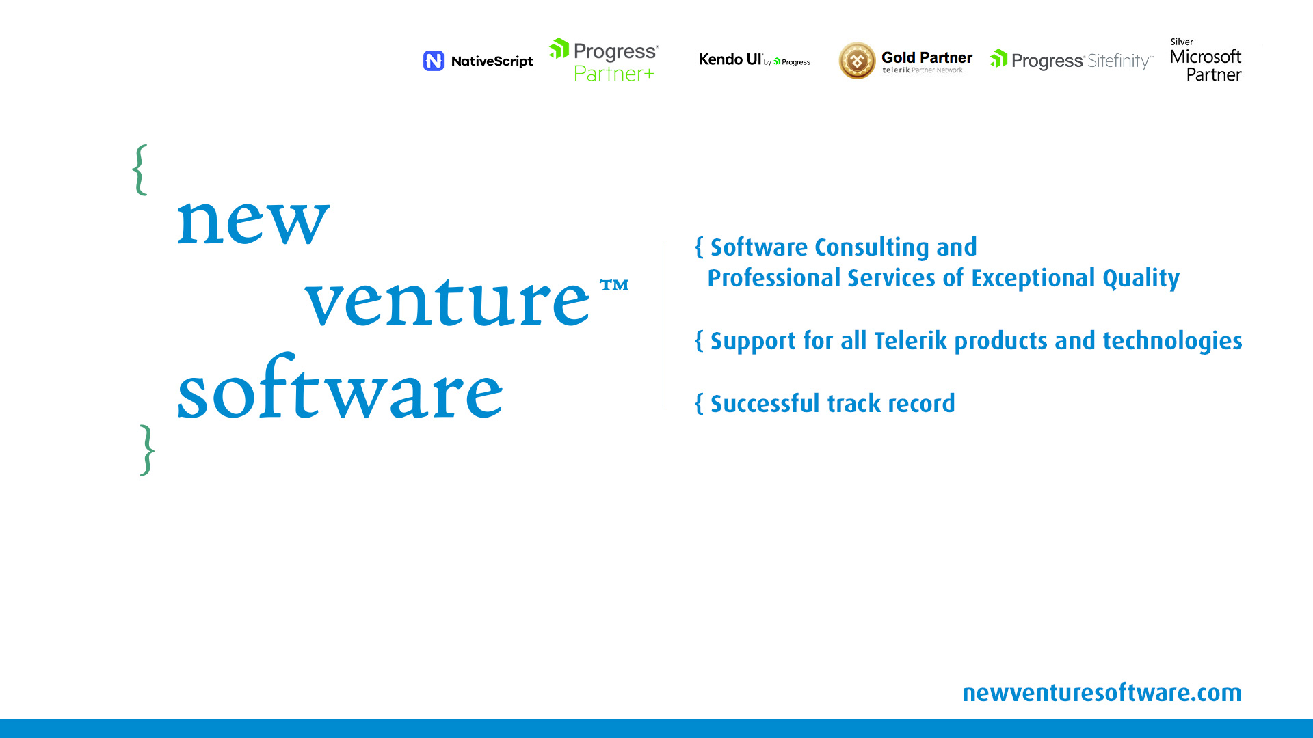
Notes:
A premium consulting and professional services partner for Progress Telerik products and technologies, who’s been instrumental in building the award-winning DevCraft suite.
The exceptional quality of our consulting and professional services stems from a solid background and expertise in Telerik DevCraft. Most of us are ex-Progress Telerik software architects who have led a number of teams building the Telerik DevCraft suite.
We support all progress Telerik products and technologies be it for the web, desktop or mobile and have a successful track record of delivering future-proof software consulting and development solutions.
My teammates and I feel honored and excited to have the opportunity to share with you our experience and passion about the Telerik technologies.

Slide 6

{Agenda}
What is Kendo UI for jQuery
Installation and Setup of Kendo
Basic Widgets
Advanced Widgets
Templates
Data Source
Validation
Globalization
Localization
Conversational UI
Theme Builder

Slide 7
{jQuery}
Been around since 2006
Used by 73% of the top 100k sites
Open Source
Simple and easy to use
Extensive browser support
[Demo]

Slide 8

{jQuery Plugins}
Simply a new method that extends jQuery's prototype object.
Anyone can build one.
[Demo]
Notes:
-Add basic plugin
-Add parameter

Slide 9
A complete JavaScript UI component library that allows you to quickly build web apps using your framework of choice.

Slide 10

Data Source
Validation
Globalization
Templates
Drag & Drop
MVVM
Export
Components

Slide 11
{Kendo UI Core vs Professional}
Kendo UI Core:
Open source or commercial projects not requiring dedicated technical support or line-of-business style functionality
Price: Free
Kendo UI Pro:
Line-of-business and professional applications requiring expert and timely technical support
Price: starting at $899
Comparison: https://www.telerik.com/kendo-ui/comparison

Slide 12



{Tools we will need}
Node.js
https://nodejs.org/en/download/current/
VSCode
https://code.visualstudio.com/
LiveServer
npm install –global live-server
GitHub
https://git-scm.com/downloads
https://github.com/newventuresoftware/<project>

Slide 13
{Where to get Kendo UI}
Zip file deployment
CDN Deployment:
http://kendo.cdn.telerik.com/<VERSION>/js/<FILENAME>.min.js
http://kendo.cdn.telerik.com/<VERSION>/styles/<FILENAME>.min.css
NPM
npm install --save kendo-ui-core
npm install --save @progress/kendo-ui
NuGet
Custom download

Slide 14
{What to include – 1}
Copy Theme Files
Directories: fonts, images, textures, stylesheets
Stylesheets
<link rel="stylesheet" href="./styles/kendo.common.min.css">
<link rel="stylesheet" href="./styles/kendo.<Theme Name>.min.css">

Slide 15
{What to include - 2}
JavaScript files: jQuery, Kendo UI, JSZip & pako_deflate (for exporting functionality), RTL (for right-to-left apps)
JavaScript
<script src="./scripts/jquery.min.js"></script>
<script src="./scripts/kendo.all.min.js"></script>
Documentation:
https://docs.telerik.com/kendo-ui/intro/installation/getting-started

Slide 16

{Short Break}
Please take ~10 minutes to relax and recharge

Slide 17
{Creating our first widget}
Creating a KendoDatePicker from <input> field.
Widget Instance vs DomObject (jQuery wrapper)
Accessing the data object
data(‘<WidgetName>’)
getKendo<WidgetName>
Using the API
Hooking up events
Events in the config options vs bind/unbind
[Demo]

Slide 18
{Destroying a widget}
Using the destroy function
Deletes the widget instance
Removes auto generated HTML content
Destroys all child widgets
$('#myGrid').data('kendoGrid’).wrapper.remove();
$('#myGrid').data('kendoGrid').destroy();
[Demo]
Notes:
-Add types to

Slide 19
{Wrapper vs Element}
Usually they are the same.
Wrapper is a <div> and differs when widget is initialized from something else
Accessing the element:
var element = $(‘#grid’).data('kendoGrid').element;
Accessing the wrapper
var wrapper = $(‘#grid’).data('kendoGrid’).wrapper;
[Demo] transforming <table> to <div>
Notes:
-Add sorting/filtering to grid
-Add types to the grid columns

Slide 20
{Initializing widgets from markup}
Grid
Menu
TabStrip

Slide 21
{Initializing widgets with code/data}
Autocomplete
Color-picker
Masked input

Slide 22
{Short Break}
Please take ~10 minutes to relax and recharge

Slide 23
{Kendo DataSource – 1}
Separation of concerns
Retrieve from a remote endpoint
Maintain the data type and the structure
Process serialization formats to and from an endpoint (ISO 8601)
Handles CRUD operations

Slide 24
{Kendo DataSource – 2}
Maintain an in-memory data caching
Provide query mechanism via filter expressions
Handles sorting, paging, grouping and aggregates. Local and Server.
Specific types of data sources
[Demo] - Synchronization
Notes:
-Others: GanttDataSource, HierarchicalDataSource, SchedulerDataSource

Slide 25
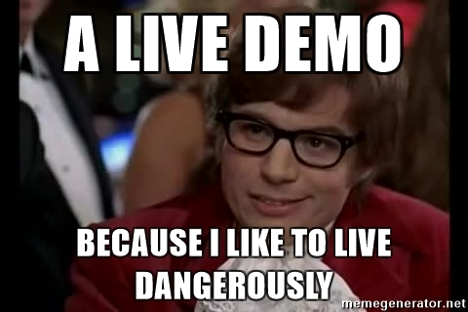
{Kendo DataSource – 3}
Transport object
OData
Aggregates
[Grid Demos 2, 3]
[Advanced Demo – Server operations]
Notes:
-Show records returned in debug console
-Talk about postman

Slide 26
{Short Break}
Please take ~10 minutes to relax and recharge

Slide 27
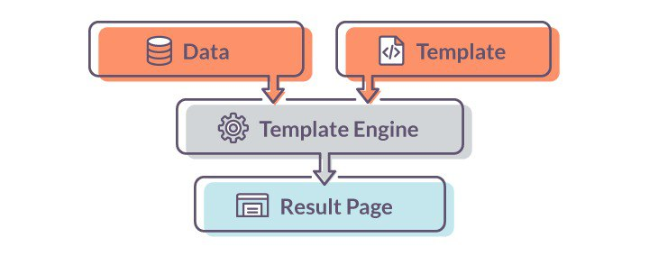
{Templates - 1}

Slide 28
{Templates – 2}
Script tag container with x/kendo-template
Render values as raw HTML:
#= value #
Display HTML encoded values:
#: value #
Execute arbitrary JavaScript code:
# if(true) { # "Non-script content..." # } #
[Demo]
Notes:
-show template function

Slide 29

{Validation}
Based around HTML5 validation
Using attributes
Old browsers offer no support for HTML5 form validation.
The support for HTML5 forms in modern browsers is incomplete.
The validation error messages created by the browser are difficult or impossible to re-style.
[Demo]
Notes:
-polyfill
-first check browser support

Slide 30
{Short Break}
Please take ~10 minutes to relax and recharge

Slide 31
{Localization}
The process of adapting software to meet the requirements of local markets and different languages.
Set the current language using messages file:
<script src="kendo.messages.bg-BG.js"></script>
Should be included before the widgets are initialized
[Demo]
Notes:
-Show the messages file

Slide 32
{Globalization}
KendoUI supports different cultures and their respective date/time/number formats.
Default English culture is defined directly in kendo.core.js as “en-US”.
[Demo] file
Add culture file: <script src="kendo.culture.en-GB.js"></script>
Set culture with code: kendo.culture('en-GB’);
The culture must be set before any Kendo UI widgets that rely on it, are initialized.
Follows naming convention:
kendo.culture.<language code>[-<country/region code>].js
[Demo]
Notes:
-Show the culture file

Slide 33
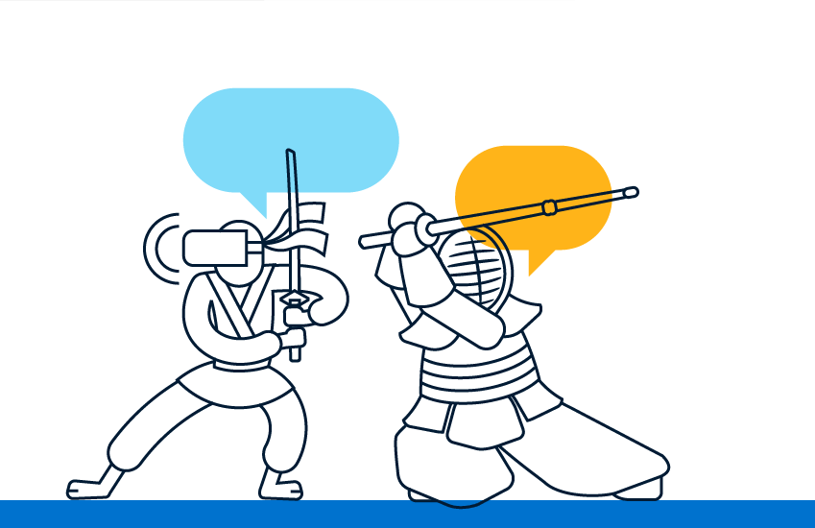
{Chatbots}
Knowledge and Transactional chatbots
Smart chatbots
Benefits
Cost savings
Automation of repetitive tasks
24/7
Scalable
Engaged users
Customer Satisfaction
Notes:
Although Kendo UI is a pretty mature framework it is regularly updated with new features following the latest trends in software development. One such trend is the focus of the latest Kendo update – it is called conversational ui.
Chatbots are another area which we believe will gain more traction in the future.
2 types of bot… limited amount of specialized processes that replace the need to talk to a person or use complicated UIs
Not one likes stupid bots
Benefits
------------------------------------------------------------
There are generally two types of chatbots. We have all heard or used Alexa, Cortana, Siri and Google Assistant. These are the so called knowledge chatbots, which are trained on enormous amount of data and aim to help the user making a decision or providing the requested information. On the other hand, there are the transactional chatbots, whose purpose is to execute a limited amount of specialized processes that replace the need to talk to an expert, or to use complicated Uis such as long forms or processes. Think what a bank operator can do for you over the phone – verify identity, block stolen credit card, provide working hours for nearby branches, or help out with information about outgoing transfer. Other examples could be booking a doctor appointment, buy a vacation, food or insurance. All these, are very good cases for where a transactional chatbot can deliver value, by helping the customers 24/7 without the need for large operator teams to pick up the phone.
There is a catch though. No one likes, stupid chatbots, so it is very important to utilize Natural Language Understanding service and to train your bot properly, so your users never get blocked. A rule of the thumb is that a user using the chatbot should be able to finish their task faster than using other means (e.g. filling a form or a phone call).

Slide 34
{Conversational UI}
Easy to navigate and engaging
Cover web, mobile and desktop
Framework agnostic
Deliver natural conversation flow
Part of your app with same look and feel
No need for external channels
Demo
Notes:
Information presentation – easy to understand and engaging
Introduced conversational UI in W M D.
Framework agnostic, easy to use, aid natural conv flow, no need to another channel – use your app
Another thing that have to be considered is presentation of the information in a easy to understand, and engaging way. This is where we decided our expertise can help and we introduced the Conversational UI story across the board of all of our UI product lines to aid developers in the implementation of engaging chatbots, whether in mobile, desktop or web applications.
The Conversational UI components, are framework agnostic, which means, not matter which framework you utilize, you can use Conversational UI for your user experience. They are easy to implement and provide the means to deliver natural conversation flow and most importantly, you can embed these bots in your existing applications with the same look and feel and without the need to send your users to external channels such as facebook, skype, etc

Slide 35

{Theme Builder}
New: http://themebuilder.telerik.com/kendo-ui
Old: http://demos.telerik.com/kendo-ui/themebuilder/

Slide 36

Kendo Dojo
http://dojo.telerik.com/

Slide 37

{Resources}
Kendo UI Documentation:
https://docs.telerik.com/kendo-ui/
Kendo UI API reference:
https://docs.telerik.com/kendo-ui/api/javascript/
Kendo UI Demos:
https://demos.telerik.com/kendo-ui/
Kendo UI Dojo:
https://dojo.telerik.com
Kendo UI Blog:
https://www.telerik.com/blogs/kendo-ui
New Venture Software’s Blog:
https://www.newventuresoftware.com/blog

Slide 38
{The End}
Thank you for attending the Progress Virtual Classroom!
This concludes today’s training. Feel free to submit any remaining questions and we will do our best to reach out to everyone.

